Slide 1

Crazy Putting! Group 4
This Photo by Unknown Author is licensed under CC BY-SA

Slide 2
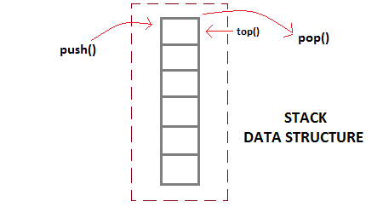
Physics

Slide 3

Terrain

Slide 4
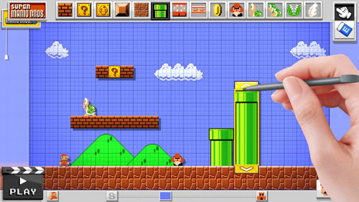
Course designer
This Photo by Unknown Author is licensed under CC BY-SA

Slide 5

Playing the game

